Slide 1

Analysis of Signature Verification System
JORHAT ENGINEERING COLLEGE
DEPARTMENT OF COMPUTER SCIENCE AND ENGINEERING
Presented by :
1. Pankaj Saha (CS-26/16)
2. Himjyoti Das(CS-48/16)
3. Akhirul Alom Mondal (CS-33/16)
4. Rajan Sahu (CS-37/16)

Slide 2
Presentation Outline
Introduction
Motivation
Proposed Approach
- System-Flow Diagram
- Preprocessing
- Feature Extraction
- Feature Matching
- Classification Algorithms
Performance Evaluation
Conclusion

Slide 3
Introduction
The image of the human signature is able to extract dynamic and spatial information of the signature. On which we apply image preprocessing techniques and thereby finding the performance in terms of accuracy.
Then the classification is done with sample images in database obtained from those individuals whose signatures have to be authenticated.

Slide 4
Motivation
Now-a-days, many fraud things happens if any unknown person wants to imitate another person’s identity.
If a person sign the name of the checking account holder without having account holder’s permission, then this procedure is considered as Signature Forgery. This is a common phenomenon in banks,offices etc.
Therefore, signature verification is essential in day-to-day life.

Slide 5
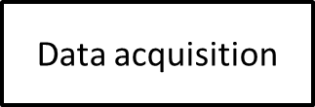
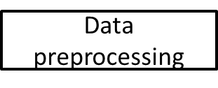

Proposed Approach: System Flow Diagram
Feature Extraction
Feature Matching
Accuracy percentage
Accuracy percentage
Analysis

Slide 6
Data Acquisition and Preprocessing
Data acquisition
- Collection of data sets
Preprocessing
- Extraction of signature block from scanned document
- Conversion to Grayscale image
- Size Normalization
- Filtering

Slide 7
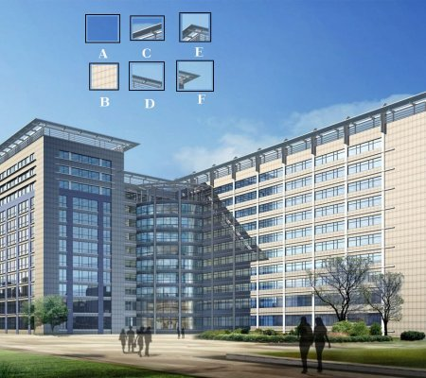
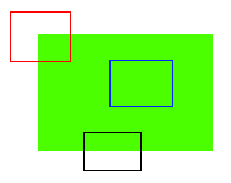
Feature Extraction
What are features ?
Why are they important ?
How do we detect features ?

Slide 8


1. Scale Invariant Feature Transform(SIFT)
SIFT is feature detection algorithm in computer vision to detect and describe local feature in images. It is based on difference between gaussian function.
Total Feature key points detected = 78

Slide 9

2. Speeded Up Robust Features(SURF)
Speeded Up Robust Features is a patented algorithm used mostly in computer vision tasks and tied to object detection purposes. SURF fall in the category of feature descriptors by extracting keypoints from different regions of a given image and thus is very useful in finding similarity between images.
Total Feature key points detected = 95

Slide 10
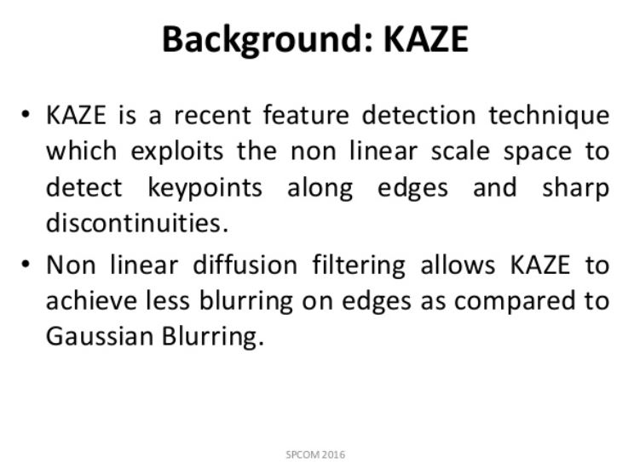
KAZE:KeyPoint Detection

Slide 11
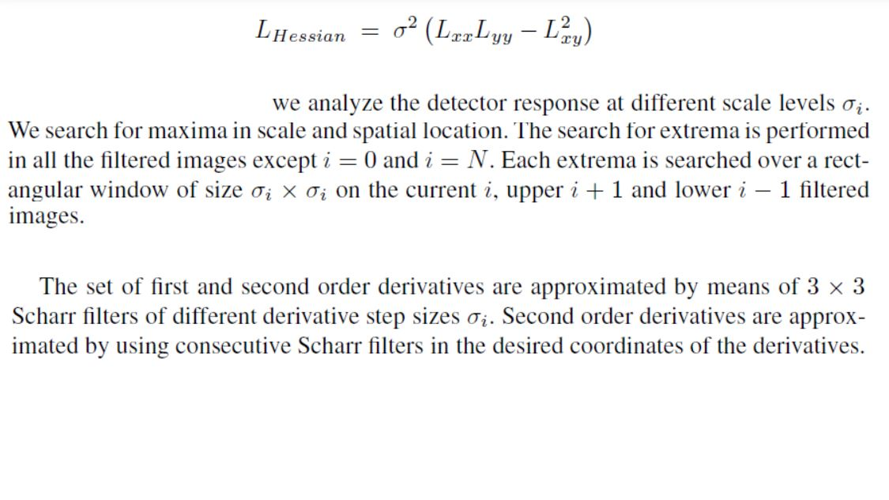
KAZE:KeyPoint Detection

Slide 12
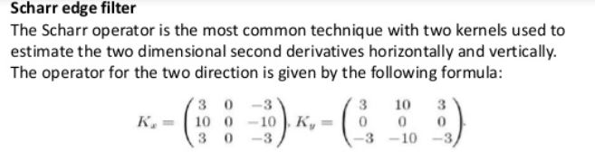

Total Feature key points detected = 96

Slide 13
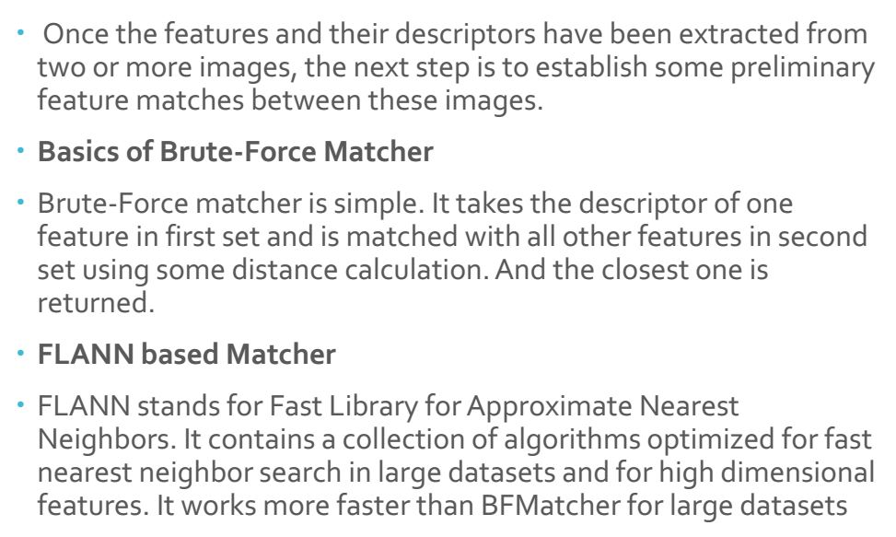
Feature Matching

Slide 14
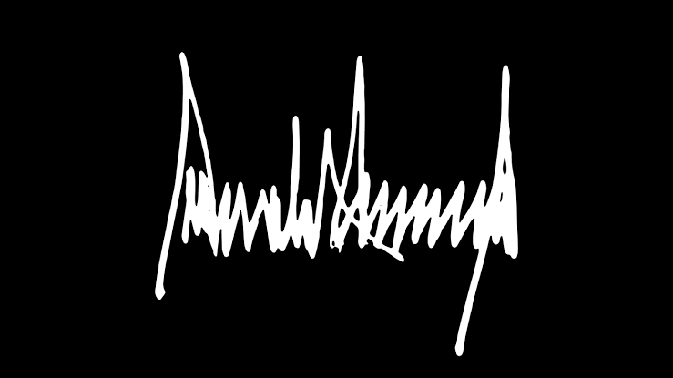
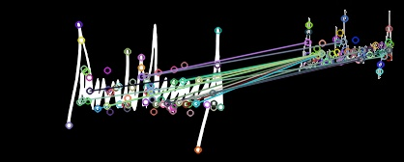
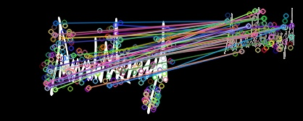
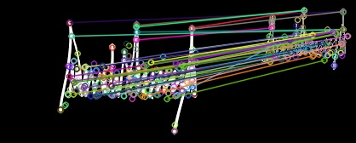
Original signature Forged signature SIFT feature matching Similarity accuracy=25.64% SURF feature matching Similarity accuracy=42.10% KAZE feature matching Similarity accuracy=40.62%

Slide 15
K-Nearest Neighbour
Global features from the signatures are extracted using random transform. For each registered user in the system database a number of reference signatures are enrolled and aligned for statistics information extraction about his signature. Extreme points warping algorithm is used to align two signatures.
During the k-nearest neighbor classifier training, a number of genuine and forged signatures are chosen. A test signature's verification is established by first aligning it with each reference signature for the claimed user. The signature is then classified as genuine or forgery, according to the alignment scores which are normalized by reference statistics, using standard pattern classification techniques.

Slide 16
How Does KNN Work?
In KNN, K is the number of nearest neighbors. The number of neighbors is the core deciding factor. K is generally an odd number if the number of classes is 2. When K=1, then the algorithm is known as the nearest neighbor algorithm.
Suppose P1 is the point, for which label needs to predict. First, you find the one closest point to P1 and then the label of the nearest point assigned to P1.

Slide 17
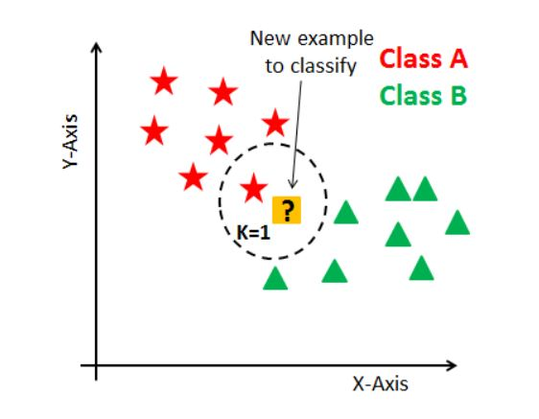
How Does KNN Work?

Slide 18
How Does KNN Work?
Suppose P1 is the point, for which label needs to predict. First, you find the k closest point to P1 and then classify points by majority vote of its k neighbors. Each object votes for their class and the class with the most votes is taken as the prediction. For finding closest similar points, you find the distance between points using distance measures such as Euclidean distance, Hamming distance, Manhattan distance and Minkowski distance.
KNN has the following basic steps:
1. Calculate distance
2. Find closest neighbors
3. Vote for labels

Slide 19
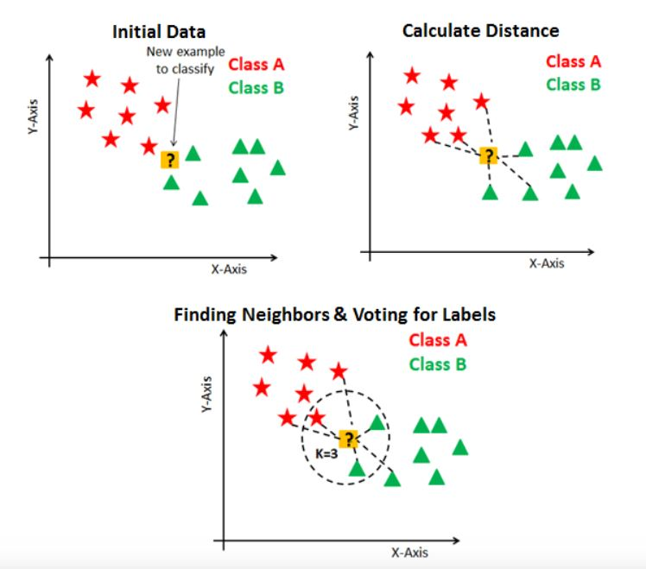
How Does KNN Work?

Slide 20
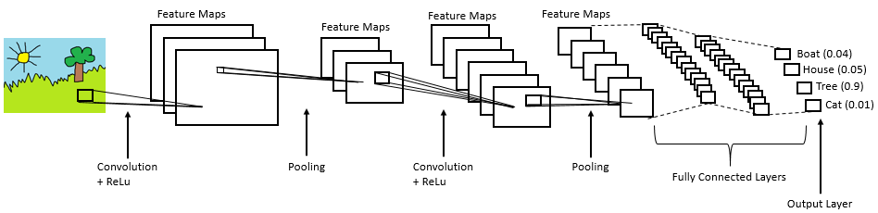
Convolutional Neural Network (CNN)
It mainly consists of the following three layers:
Convolutional layer
Pooling layer
Fully Connected layer

Slide 21
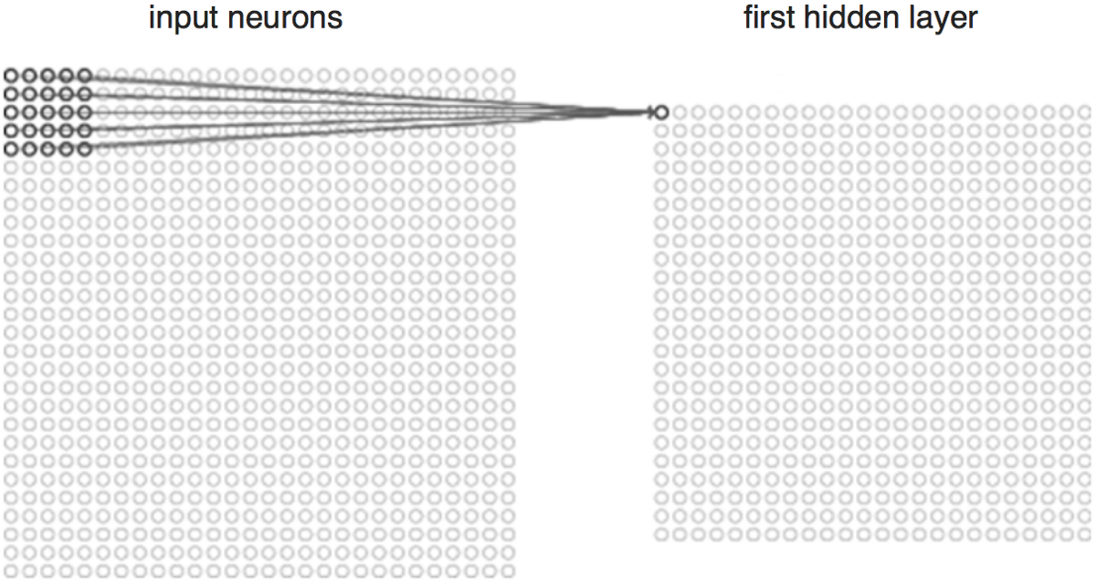
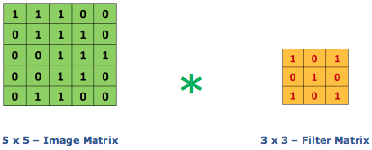
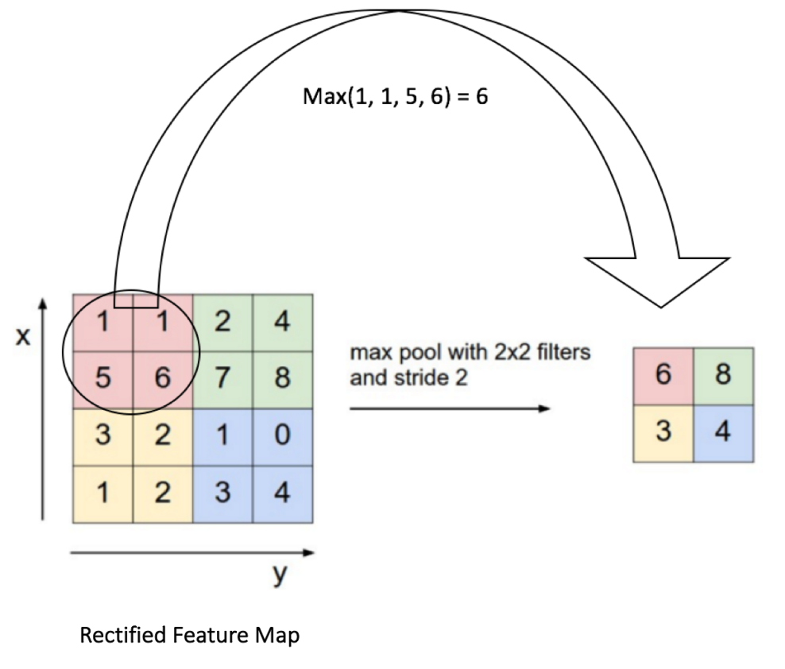
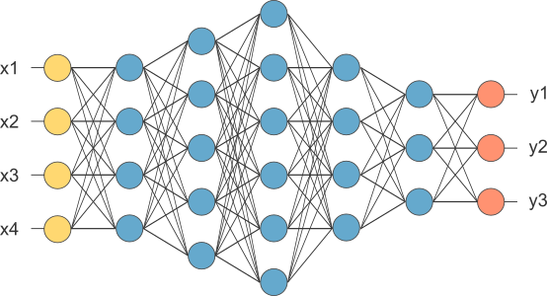

Slide 22
Performance Evaluation
Dataset:
This database has been taken from Kaggle to conduct research on signature verification. Contains genuine and forged signatures of 30 people. Each person has 5 genuine signatures which they made themselves and 5 forged signatures someone else made. The naming of images is explained here.NFI-00602023 is an image signature of person number 023 and done by person 006. This is a forged signature.NFI-02103021 is an image of signature of person number 021 done by person 021. This is a genuine signature.

Slide 23
Performance Evaluation
Techniques(algorithms) Used | Accuracy Percentage
SIFT | 25.64%
SURF | 42.10%
KAZE | 40.62%
KNN | 87.63%
CNN | 97.10%

Slide 24
Conclusion
It is experimentally verified that CNN model with approx 97% accuracy has the best result compared with the traditional feature extraction algorithms like SIFT, SURF, Kaze as well the KNN algorithm which showed an accuracy of approx 88%.
Moreover CNN is also has more memory efficiency as it reduce the size of the training data and just retain the information which are neccesary and do not add extra information.

Slide 25
THANK YOU

